Slide 1

Advanced Graph Convolution Networks for MRI - Based Brain Tumor Segmentation
Under the Guidance of:
Dr. B.L. Velammal
Associate Professor, Department of CSE
Team Members:
Pari PS - 2021103029
Kavishkumar K - 2021103321
Pal Dhinakaran P - 2021103736
Kesavarajamanikandan K - 2021103733

Slide 2
Introduction
Brain tumor segmentation plays a crucial role in medical image analysis by aiding in tumor detection and treatment planning, contributing to accurate diagnosis, prognosis prediction, and surgical planning. However, tumor heterogeneity and challenges associated with MRI imaging make segmentation a complex task.
The segmentation process faces challenges due to the irregular shapes and boundaries of tumors, the presence of artifacts, noise, and varying resolution in MRI scans, and the difficulty in accurately delineating different tumor regions such as the whole tumor, tumor core, and enhancing tumor.
The goal of this project is to develop an accurate, efficient, and robust model for brain tumor segmentation while improving performance in terms of key evaluation metrics such as the Dice similarity coefficient and Accuracy.

Slide 3
Objectives
Develop an Accurate Brain Tumor Segmentation Model:
Create a model that can effectively segment different tumor regions (whole tumor, tumor core, enhancing tumor) across multiple MRI modalities.
Ensure high accuracy in delineating tumor boundaries.
Integrate Multi-modal MRI Data:
Fuse information from various MRI sequences (T1, T2, FLAIR, T1c) to enhance feature extraction and improve segmentation precision.
Leverage complementary information from multi-modal MRI for more comprehensive tumor analysis.
Improve Feature Representation:
Incorporate a multi-modal graph convolution network (M2GCNet) to capture both spatial and contextual features.
Design and implement a multi-modal correlation loss (CLoss) to learn latent relationships between features from different modalities.

Slide 4
Literature survey
 | Name of the Paper | Methodology | Advantages | Limitations
1. | 3DUV-NetR+: A 3D hybrid semantic architecture using transformers for brain tumor segmentation with MultiModal MR images. Results in Engineering, 21, p.101892.(Aboussaleh, I., Riffi, J., el Fazazy, K., Mahraz, A.M. and Tairi, H., 2024) | Developed 3DUV-NetR+, a fusion of 3D U-Net and V-Net encoders with a Transformer decoder | Achieves high segmentation accuracy, enhances tumor sub-region differentiation, leverages robust feature extraction, and has potential for clinical integration. | Further fine-tuning is required to minimize execution time and enhance segmentation efficiency.
2. | DAUnet: A U-Shaped Network Combining Deep Supervision and Attention for Brain Tumor Segmentation (Y. Feng, Y. Cao, D. An, et al., 2024) | The DAUnet model segments brain tumors in MRI images using deep supervision, 3D SC attention, and a CASP module. | DAUnet achieves high segmentation accuracy by effectively preserving feature information and enhancing the correlation between network layers. | The combination of multiple advanced modules increases implementation difficulty and makes hyperparameter tuning more challenging.
3. | Inception-UDet: An Improved U-Net Architecture for Brain Tumor Segmentation (I. Aboussaleh, J. Riffi, A.M. Mahraz, et al., 2024) | Enhances U-Net with Inception blocks and Bi-FPN, using preprocessing, data augmentation, and k-fold cross-validation on BraTS datasets. | Improves segmentation accuracy, captures multi-scale features, and outperforms existing models in DSC scores. | The addition of Inception blocks and Bi-FPN increases the number of parameters, making the model harder to train and optimize.

Slide 5
S.no | Name of the Paper | Methodology | Advantages | Limitations
4. | Brain tumor segmentation and classification using optimized deep learning. Journal of Computing & Biomedical Informatics, 7(01), pp.632-640(Khan, M.F., Iftikhar, A., Anwar, H. and Ramay, S.A., 2024) | The study utilizes CNN-based deep learning models with data augmentation and denoising applied to MRI images from multiple datasets to enhance tumor detection accuracy. | Improves detection efficiency, achieves high accuracy, enhances feature extraction, and reduces manual effort in brain tumor diagnosis. | The fused optimization scheme used for feature selection may not always generalize well across different datasets.
5. | MmcFormer: Missing Modality Compensation Transformer for Brain Tumor Segmentation (S. Karimijafarbigloo, R. Azad, A. Kazerouni, et al., 2024) | Uses a transformer-based architecture to compensate for missing MRI modalities in segmentation tasks. | Works well even with incomplete multi-modal MRI data. | Training Transformers on volumetric MRI data is slower compared to CNN-based approaches due to self-attention operations
6. | ETUNet: Exploring Efficient Transformer Enhanced UNet for 3D Brain Tumor Segmentation (W. Zhang, S. Chen, Y. Ma, et al., 2024) | ETUNet integrates 3D CNN and Transformers with PoolFormer-based encoding, ESCA blocks, and MSFCA modules for efficient and precise brain tumor segmentation. | Balances accuracy and computational efficiency in 3D segmentation. | A potential three-step segmentation approach (WT → TC → ET) could improve accuracy but would also increase model complexity.

Slide 6
Summary of Issues
Lack of Experimental Validation – Some papers provide theoretical insights and model reviews but do not perform hands-on experiments or comparisons.
High Computational Requirements – Many advanced models (especially those using deep learning and transformers) demand significant memory and processing power, making them difficult to deploy on standard hardware.
Performance on Imbalanced Datasets – Models may struggle with datasets where tumor and non-tumor regions are highly imbalanced, leading to poor detection of smaller tumors.
Lack of Novelty – Some studies focus on dataset contributions rather than introducing new segmentation methods, limiting their impact on advancing the field.
Challenges with Missing Data – Methods relying on multi-modal MRI face difficulties when some modalities are unavailable, affecting segmentation accuracy.
Struggles with Small Tumor Regions – Even powerful models may fail to accurately detect very small or fine-grained tumor regions, reducing their effectiveness in clinical applications.

Slide 7
Proposed System
Multi-Modal Feature Fusion: Utilizes multiple MRI modalities (T1, T1c, T2, FLAIR) to improve tumor segmentation by integrating complementary information.
Graph Convolutional Networks (GCNs): Employs Spatial Graph Convolution Module (SGCM) and Channel Graph Convolution Module (CGCM) to capture spatial and inter-modal relationships.
Multi-Scale Feature Extraction: Uses dilated convolutions (rates 2, 4) to extract local and global contextual features, enhancing tumor boundary detection.
Efficient Decoder with Skip Connections: Combines CNN-based upsampling and graph-based refinement for improved spatial consistency and segmentation accuracy.
Robust and Accurate Segmentation: The M2-GCN model enhances feature learning, improving tumor segmentation performance while maintaining computational efficiency.

Slide 8
Architecture Diagram
Feature Extraction Module
Encoder
(Down sampling)
Preprocessing Module
Input
Normalization
Convolutional Layers
Convolutional layer
Resizing
Pooling Layers
Leaky ReLu
MRI Images
Preprocessed MRI images
Feature maps
Down Sampled image
Graph Convolution Module
Decoder
(Up sampling)
Final Segmentation
(Output)
Spatial wise
Convolutional layer
Tumor Segmentation Module (Testing)
Channel wise
Leaky ReLu
Up Sampled image

Slide 9
Details of modules
1. Preprocessing Module
Normalization
Raw MRI images
Preprocessed MRI images
Resizing

Slide 10
Input :
Raw MRI images (multi-modal: T1, T2, FLAIR, T1c)
Output :
Preprocessed MRI images ready for feature extraction.
Description :
This module handles the raw MRI scans by performing normalization, resizing, and data augmentation.
Different MRI modalities (T1, T2, FLAIR, T1c) are processed separately, ensuring data consistency and uniformity across modalities.

Slide 11
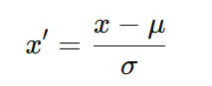
Normalization:
Standardizes the pixel intensity values of MRI images to a common scale.
Helps in reducing the impact of intensity variations across different MRI modalities (T1, T2, FLAIR, T1c).
Common methods include Z-score Normalization.
Z-score normalization is applied to standardize the intensity values of MRI images before they are used in the Graph Convolutional Network (GCN). This ensures that different modalities (Flair, T1, T1ce, T2) have comparable intensity distributions, improving model stability and convergence.
For each voxel 𝑥 in the MRI image:
where:
x′ is the normalized voxel intensity,
x is the original intensity value,
μ is the mean intensity of the entire MRI scan,
σ is the standard deviation of the MRI scan.

Slide 12
2.Resizing:
Ensures that all images have a uniform size, making them compatible with the neural network architecture.
Reduces computational complexity and memory requirements.
Maintains aspect ratio while fitting the required input dimensions.
Helps in reducing overfitting and improving model generalization.
Original Image Size:The original MRI scans in the BraTS dataset have varying spatial resolutions, typically around (240 × 240 × 155) voxels.
Target Resized Shape:In the M2GCNet model, all MRI volumes are resized to a fixed (128 × 128 × 128) resolution.This ensures uniformity across different patient scans and facilitates efficient feature extraction.

Slide 13
Pseudocode :
def preprocess_data(mri_data, ground_truth):
# Normalize the MRI data
mri_data_normalized = normalize(mri_data)
# Resample to standard resolution
mri_data_resampled = resample(mri_data_normalized)
# Apply augmentation techniques
augmented_data = augment_data(mri_data_resampled)
# Generate corresponding segmentation masks
segmentation_mask = generate_mask(ground_truth)
return augmented_data, segmentation_mask
def normalize(mri_data):
# Normalize pixel values to range [0, 1]
return (mri_data - mri_data.min()) / (mri_data.max() - mri_data.min())
def resample(mri_data):
# Resample to a fixed resolution
return resample_to_fixed_resolution(mri_data)
def augment_data(mri_data):
# Augmentation strategies like rotation, flipping, etc.
return augmented_mri_data

Slide 14
2.Feature Extraction Module:
Feature Extraction Module
Convolutional Layers
Preprocessed MRI images
Feature maps
Pooling Layers
Batch Normalization

Slide 15
Input :
Preprocessed MRI images
Output :
Feature maps containing essential spatial and texture information
Description :
The Feature Extraction Module is responsible for extracting meaningful spatial and texture features from the preprocessed MRI images. This is achieved using deep convolutional layers, which help in capturing important tumor characteristics such as edges, intensity variations, and structural patterns.

Slide 16
Convolutional Layers (Conv3D):
Role: The 3D convolutional layers in this module are responsible for learning local patterns in the MRI data. Each convolution operation applies a set of 3D filters (kernels) to the input data in three dimensions (x, y, and z axes). This allows the network to learn spatial patterns such as edges, textures, and more complex features across the volumetric MRI scans.
Details in the Code:
The model uses several 3D convolution layers with increasing filters to progressively capture more complex patterns:
First Block: Conv3D(filters=32, kernel_size=(3, 3, 3))
Second Block: Conv3D(filters=64, kernel_size=(3, 3, 3))
Third Block: Conv3D(filters=128, kernel_size=(3, 3, 3))
Fourth Block: Conv3D(filters=256, kernel_size=(3, 3, 3))
The kernel size (3, 3, 3) is used in all layers, meaning that each filter looks at a 3x3x3 patch of the input data at a time.
Purpose: These convolutions help the network to extract both low-level features (like edges and textures) and high-level abstract features (like tumor regions and tissue boundaries) from the 3D MRI data.

Slide 17
Pooling Layers (MaxPooling3D):
Role: The Max Pooling layers are used after each convolution operation to down-sample the feature maps and reduce the spatial dimensions. This not only decreases the computation cost but also helps in extracting more abstract features at higher levels while preserving the strongest activations.
Details in the Code:
After each convolution operation, a MaxPooling3D layer with a pool size of (2, 2, 2) is applied. This means that for every 2x2x2 block of the feature map, only the maximum value is retained.
Purpose: By selecting the maximum value from each region, the pooling layers help highlight the most relevant features, like the most prominent textures or boundaries, while discarding irrelevant information. This reduces spatial dimensions (height, width, depth) and increases computational efficiency.

Slide 18
Pseudo-code:
import tensorflow as tf
from tensorflow.keras import layers, models
# Define a simple 3D CNN model
def create_cnn(input_shape):
model = models.Sequential([
layers.Conv3D(32, (3, 3, 3), activation='relu', input_shape=input_shape),
layers.MaxPooling3D((2, 2, 2)),
layers.Conv3D(64, (3, 3, 3), activation='relu'),
layers.MaxPooling3D((2, 2, 2)),
layers.Conv3D(128, (3, 3, 3), activation='relu'),
layers.GlobalAveragePooling3D(),
layers.Dense(256, activation='relu'),
layers.Dense(128, activation='relu')
])
return model

Slide 19
# Create CNN for feature extraction
cnn_model = create_cnn((64, 64, 64, 1)) # Example input shape (64x64x64,
single channel)
def extract_features(image):
# Preprocess and extract features using CNN
image = preprocess_image(image)
features = cnn_model.predict(image)
return features

Slide 20
3.Encoder
Encoder
(Down sampling)
Feature maps
Convolutional layer
Down Sampled image
Leaky ReLu

Slide 21
Input :
Feature maps
Output :
Down Sampled image
Description :
The encoder in this architecture is responsible for extracting meaningful features from the input MRI images. It consists of convolutional layers for feature extraction, pooling layers for dimensionality reduction, and activation functions (Leaky ReLU) to introduce non-linearity. The processed feature maps are then passed to the Graph Convolution Module for further refinement before being decoded for tumor segmentation.

Slide 22
Pseudo-code:
Function Encoder(input_image):
# Step 1: Apply first convolutional layer
conv1 = Convolution(input_image, filter_size=3x3, stride=1, padding=1)
# Step 2: Apply activation function (Leaky ReLU)
activated1 = LeakyReLU(conv1)
# Step 3: Apply pooling layer to reduce spatial dimensions
pooled1 = MaxPooling(activated1, pool_size=2x2, stride=2)
# Step 4: Apply second convolutional layer
conv2 = Convolution(pooled1, filter_size=3x3, stride=1, padding=1)
# Step 5: Apply activation function (Leaky ReLU)
activated2 = LeakyReLU(conv2)
# Step 6: Apply another pooling layer
pooled2 = MaxPooling(activated2, pool_size=2x2, stride=2)
# Step 7: Pass the extracted features to the next module (e.g., Graph Convolution Module)
Return pooled2

Slide 23
4.Graph Convolution Module
Graph with Node Features
Graph Convolution Layer
Node Feature Updates
Pooling Layer
Global Features

Slide 24
Input :
Graph-structured feature maps
Output :
Refined feature representations with better spatial and contextual understanding.
Operations:
Spatial Graph Convolution Module (SGCM) - Enhances spatial feature learning.
Channel Graph Convolution Module (CGCM) - Enhances cross-modal feature

Slide 25
Description :
Multi-modal Graph Convolution Network (M2GCNet) Module:
SGCM (Spatial-wise Graph Convolution Module):
The SGCM captures spatial relationships in each MRI modality. It creates graphs based on the spatial structure and applies graph convolutions to understand the spatial interactions in tumor regions.
This module is responsible for extracting high-level spatial features from the MRI scans.
CGCM (Channel-wise Graph Convolution Module):
The CGCM works on the channel-wise information from each modality, capturing the complementary relationships between different modalities, such as T1 vs. FLAIR, or T2 vs. T1c.
By modeling these channel dependencies, CGCM enables a deeper understanding of the tumor's characteristics and how different modalities complement each other in identifying various tumor regions.
Multi-modal Fusion Layer:
After processing the individual modalities, the outputs from the SGCM and CGCM are fused together to create a unified representation of the tumor.
This layer consolidates the spatial and channel-wise information, offering a more complete and accurate view of the tumor's boundaries.

Slide 26
Pseudo-code:
def gcn_forward(graph, adj_matrix, features):
# Apply Graph Convolution to update node features
node_features = apply_graph_convolution(features, adj_matrix)
# Apply pooling to reduce graph size
pooled_features = apply_pooling(node_features)
return pooled_features
def apply_graph_convolution(features, adj_matrix):
# Perform graph convolution by multiplying node features with adjacency
matrix
return np.dot(adj_matrix, features)
def apply_pooling(features):
# Apply graph pooling to reduce dimensions
return np.mean(features, axis=0)

Slide 27
5.Decoder :
Decoder
(Up sampling)
Global Features
Up Sampled image
Convolutional layer
Leaky ReLu

Slide 28
Input :
Global Features
Output :
Up Sampled image
Description :
The decoder is responsible for reconstructing the segmented tumor regions from the extracted features. It uses upsampling layers to restore the spatial dimensions, followed by convolutional layers to refine the segmentation. Leaky ReLU activation is applied to enhance feature learning, ensuring accurate tumor segmentation in the final output.

Slide 29
Pseudo-code :
Function Decoder(input_features):
# Step 1: Upsampling the feature maps
upsampled_features = Upsample(input_features)
# Step 2: Apply convolution to refine features
conv1 = Convolution(upsampled_features, filter_size=3x3, stride=1, padding=1)
# Step 3: Apply activation function (Leaky ReLU)
activated1 = LeakyReLU(conv1)
# Step 4: Further refine using another convolution
conv2 = Convolution(activated1, filter_size=3x3, stride=1, padding=1)
# Step 5: Apply activation function (Leaky ReLU)
activated2 = LeakyReLU(conv2)
# Step 6: Generate segmentation mask (Final Output)
output_mask = Convolution(activated2, filter_size=1x1, stride=1, activation=Sigmoid or Softmax)
Return output_mask

Slide 30
6.Segmentation Module :
Final Segmentation
(Output)
Up Sampled image
Tumor Segmentation Module (Testing)

Slide 31
Input :
Up Sampled image
Output :
Predicted Mask
Description :
This is the core of the model that applies convolutional operations to the fused multi-modal graph features.It uses upsampling layers (or transposed convolutions) to perform segmentation, predicting the mask for the tumor regions, including whole tumor (WT), tumor core (TC), and enhancing tumor (ET).

Slide 32
Pseudo-code :
def segment_tumor(graph_features):
# Feed graph features into a segmentation network (e.g., fully connected
layers or softmax classifier)
segmentation_mask = apply_segmentation_network(graph_features)
return segmentation_mask
def apply_segmentation_network(features):
# A simple FC layer or softmax to output binary/multi-class mask
return softmax(features)

Slide 33
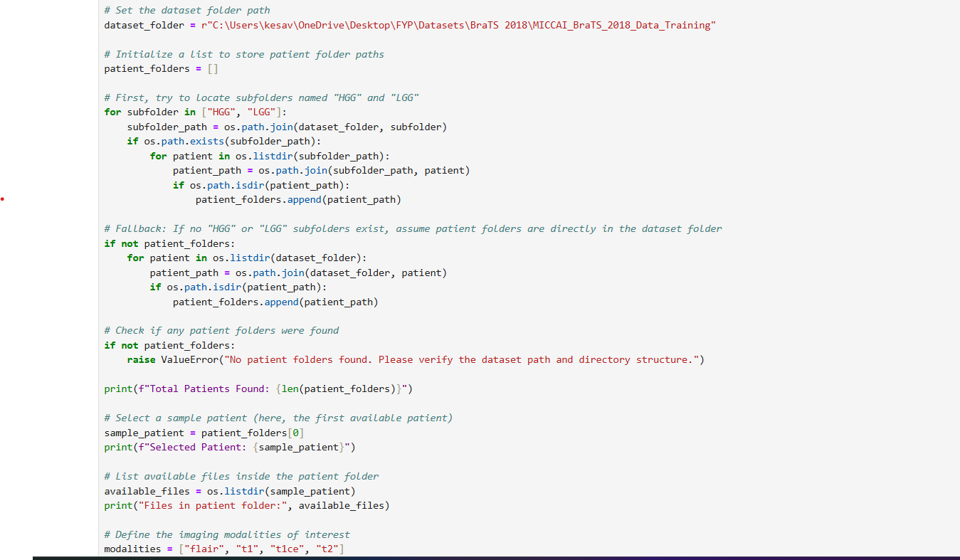
Implementation
Code

Slide 34
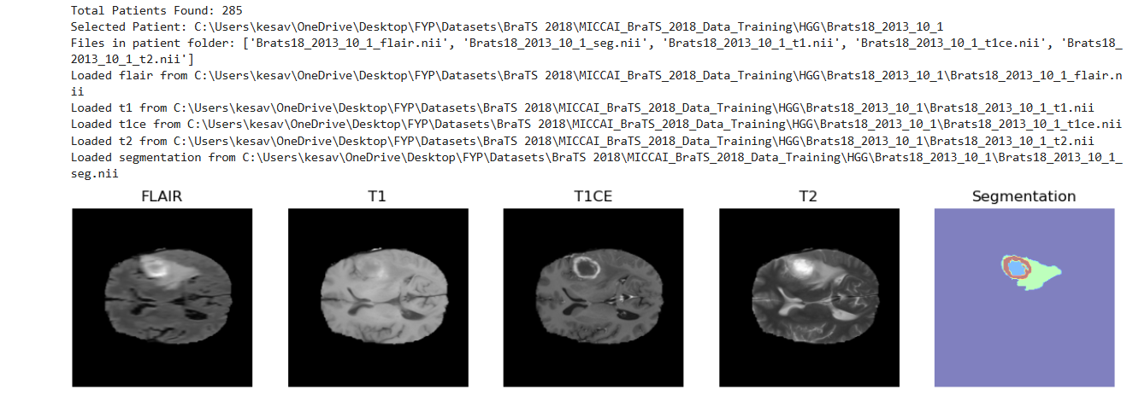
Output
BraTS 2018 Sample Data Visualization of Different Modalities

Slide 35
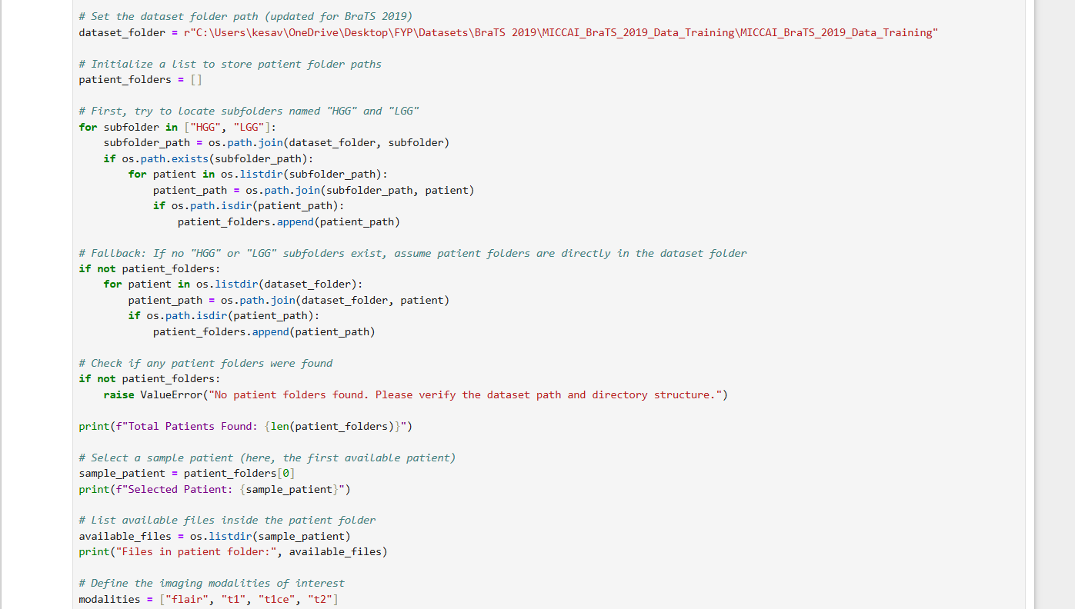
Code

Slide 36
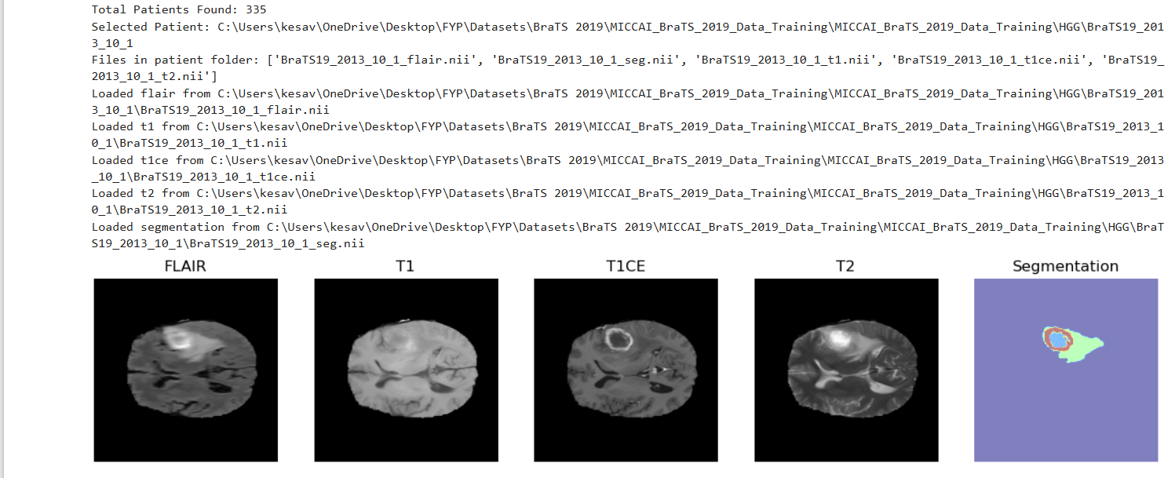
Output
BraTS 2019 Sample Data Visualization of Different Modalities

Slide 37
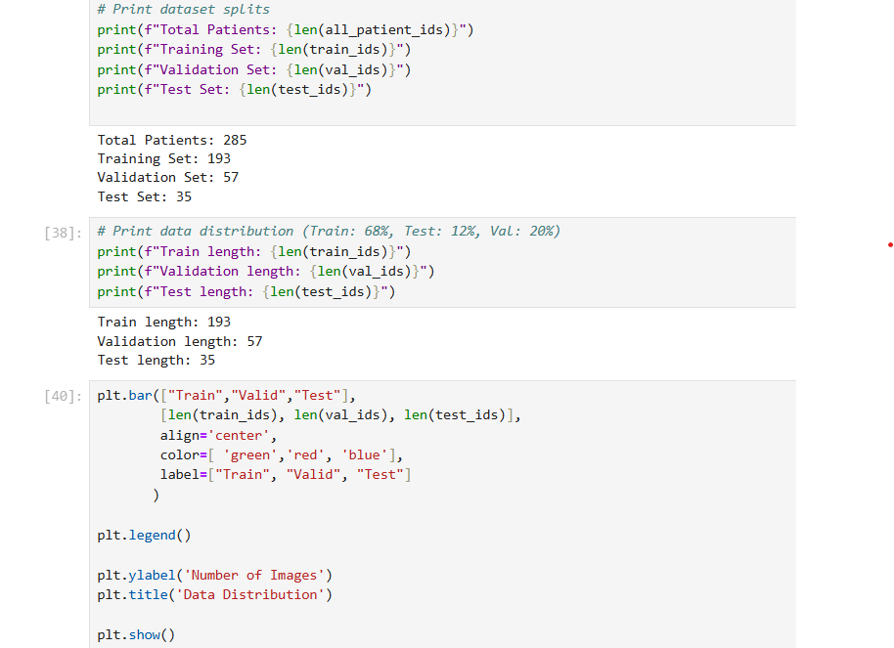
Data Splitting Code

Slide 38
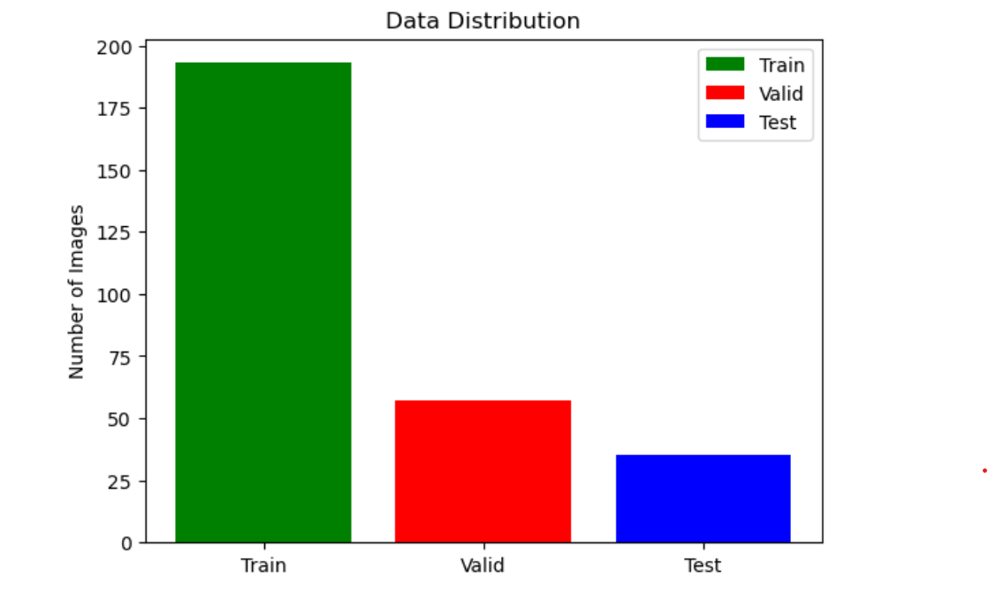
Output
Data Splitting

Slide 39
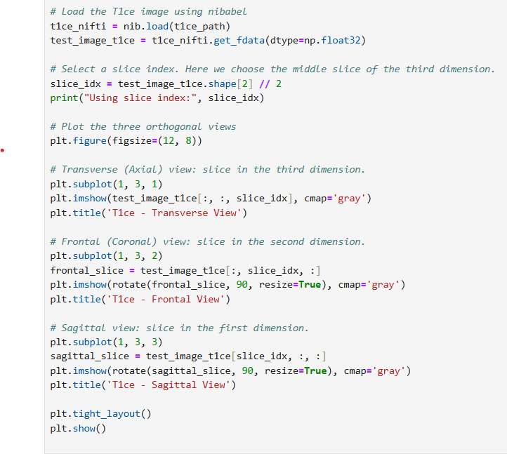
Orthogonal Views

Slide 40
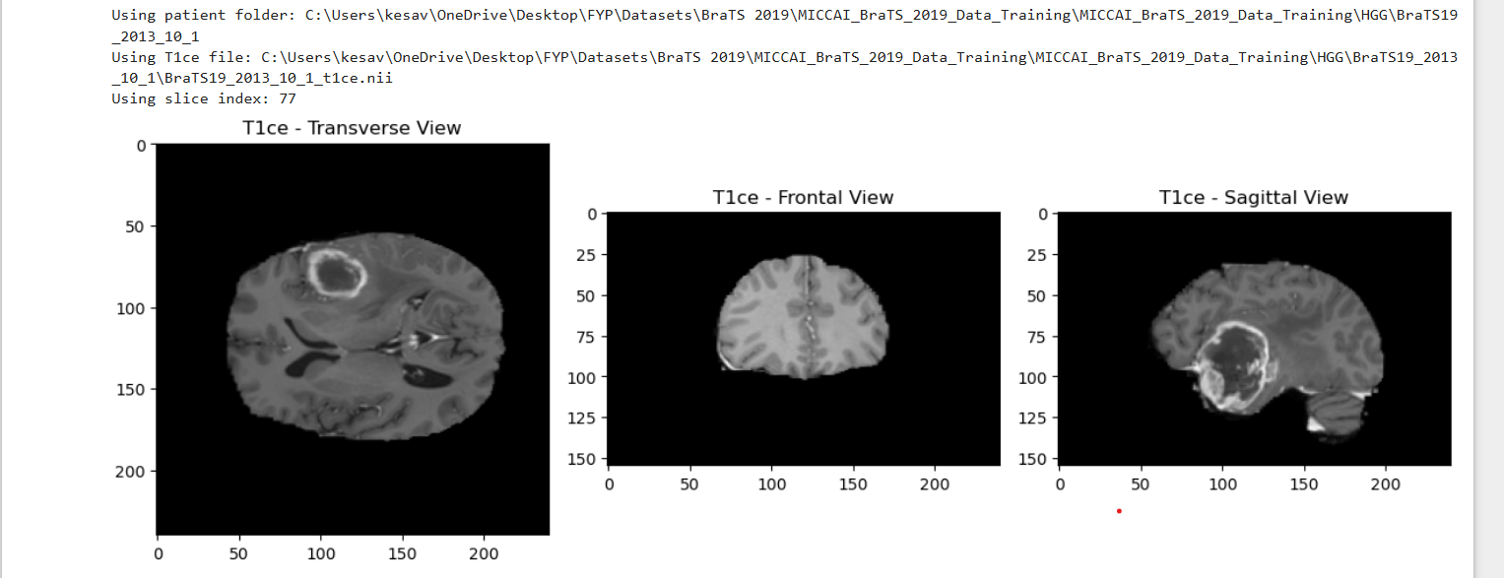
Output
Orthogonal Views

Slide 41
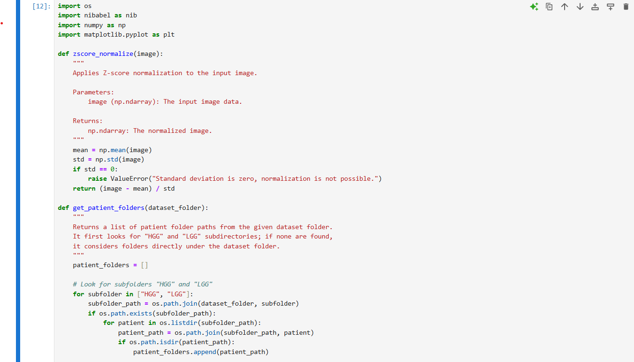
Preprocessing
Z-Score Normalization Code

Slide 42
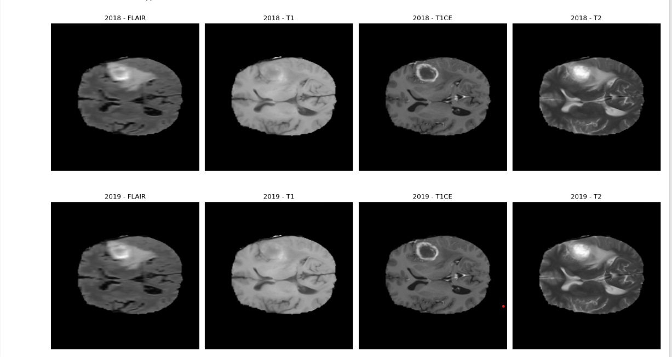
Output
Z-Score Normalization

Slide 43
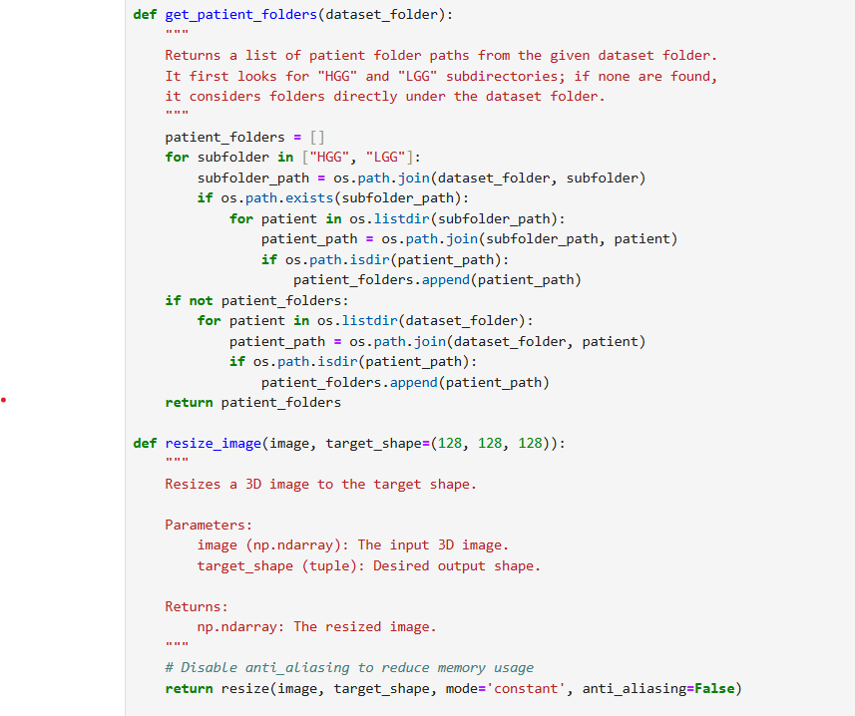
Resizing Code

Slide 44
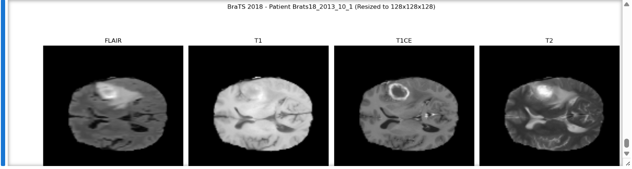
Output
Resizing 2018 Dataset

Slide 45
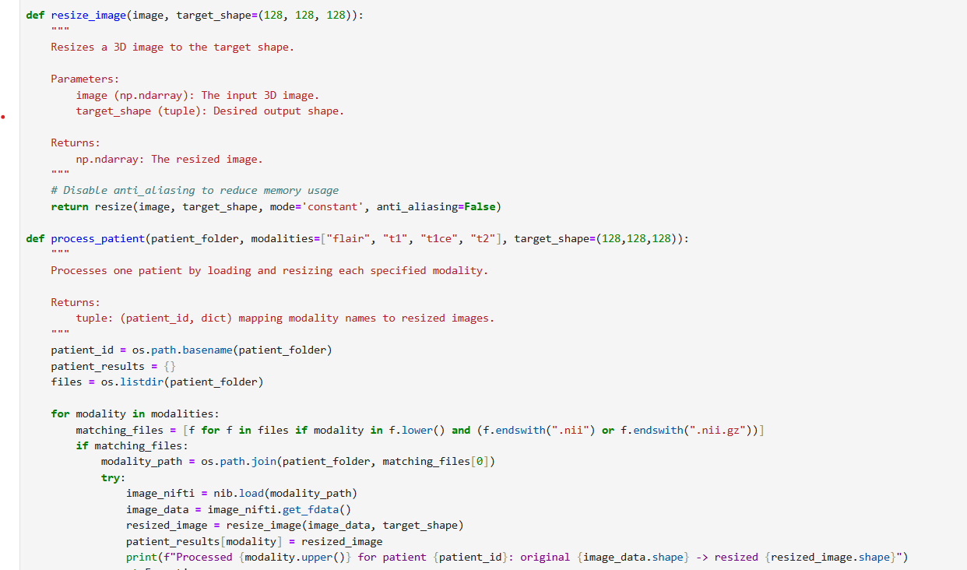
Resizing Code

Slide 46
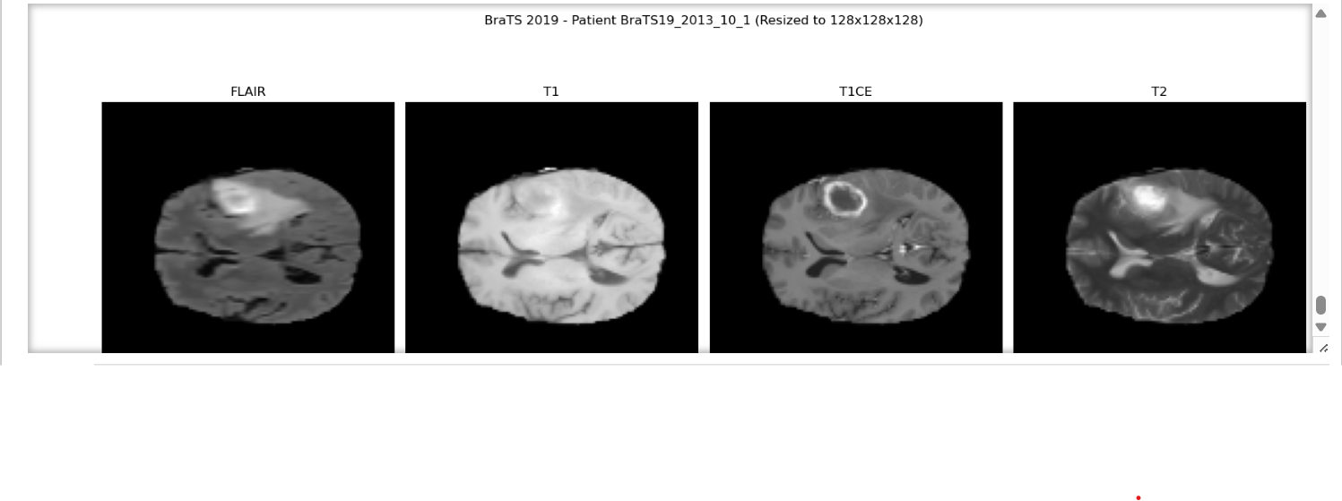
Output
Resizing 2019 Dataset

Slide 47
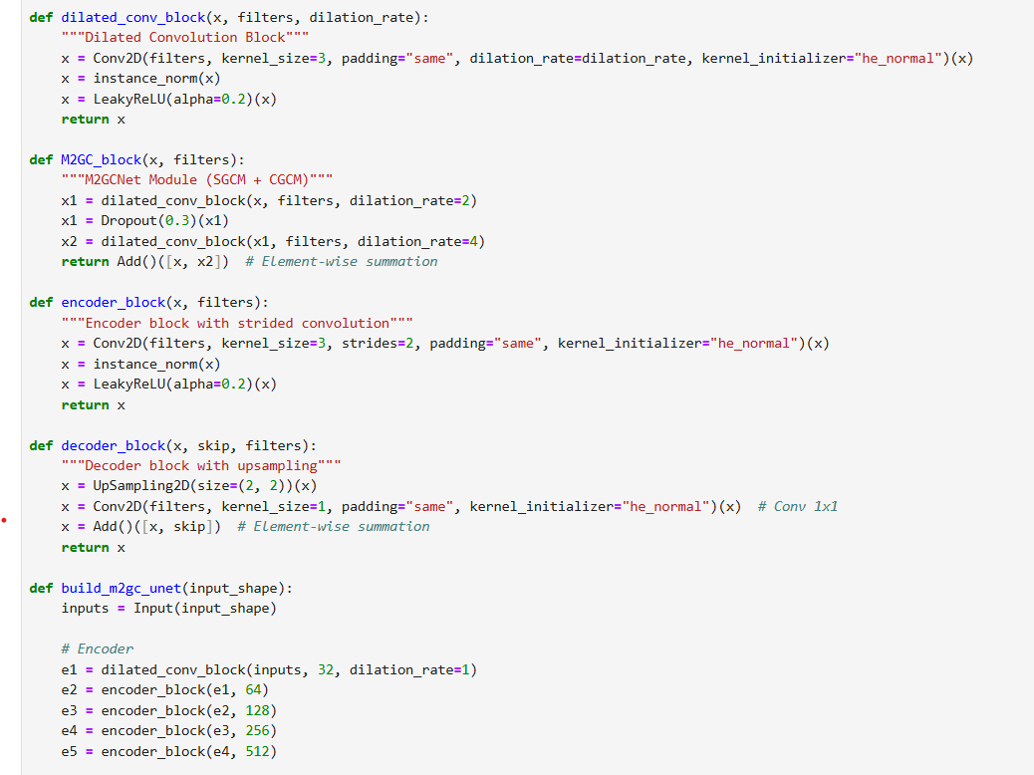
Feature Extraction
Feature Extraction Code

Slide 48
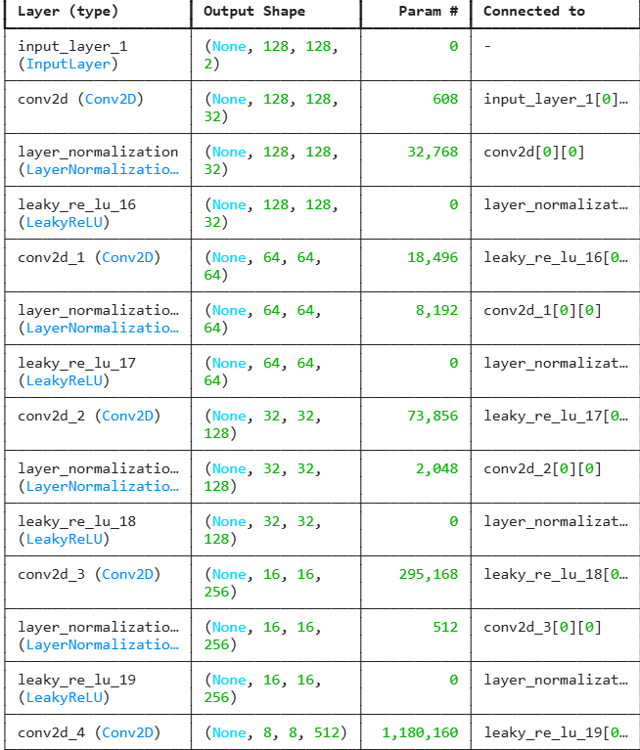
Output
Feature Extraction

Slide 49
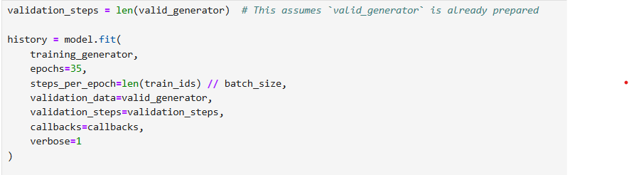
Model Training

Slide 50
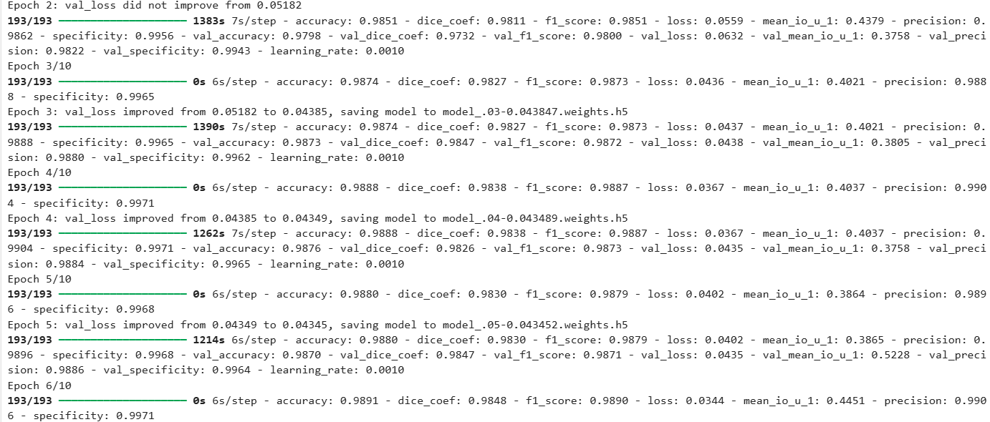
Model Training

Slide 51
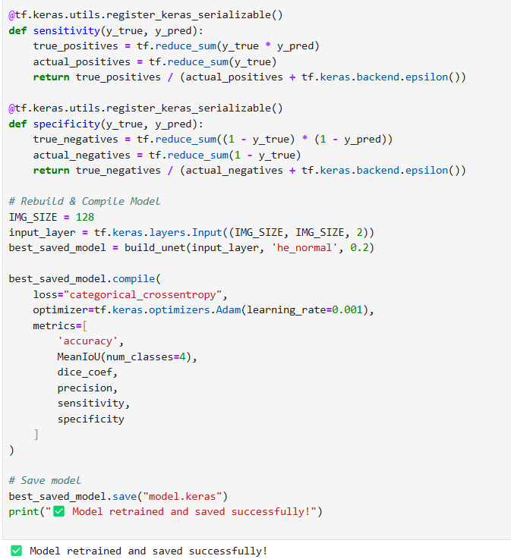

Slide 52
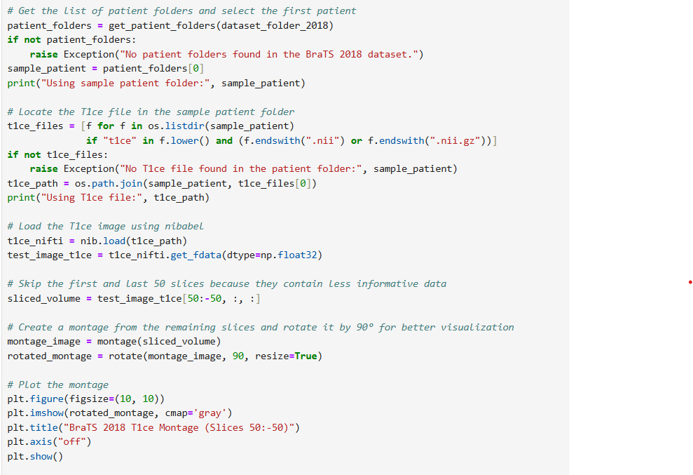
Segmentation
Montage T1ce slices 50-50

Slide 53
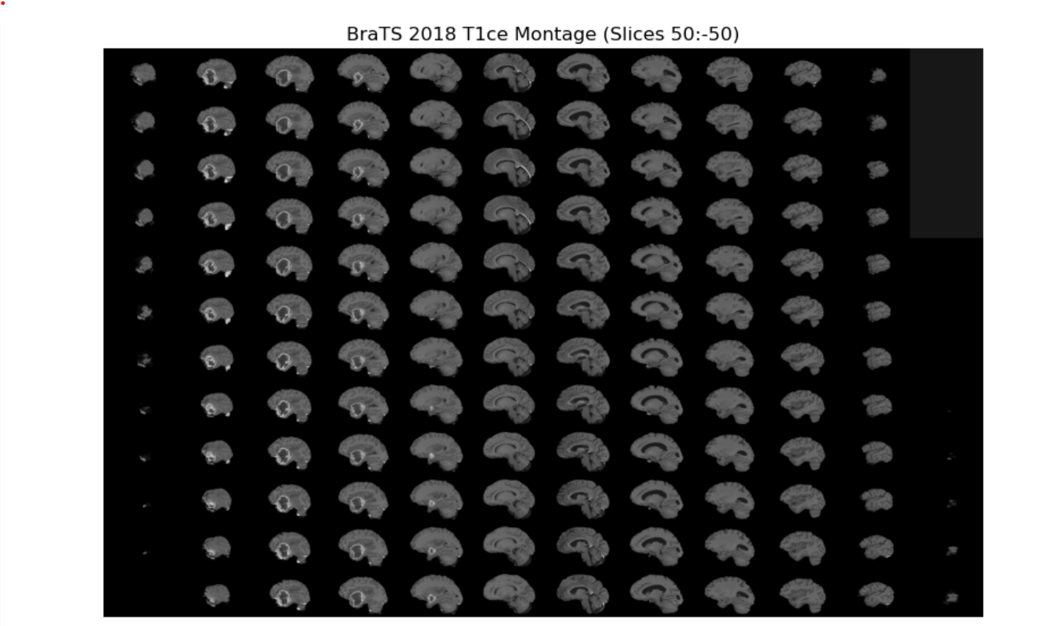
Output
Montage T1ce slices 50-50

Slide 54
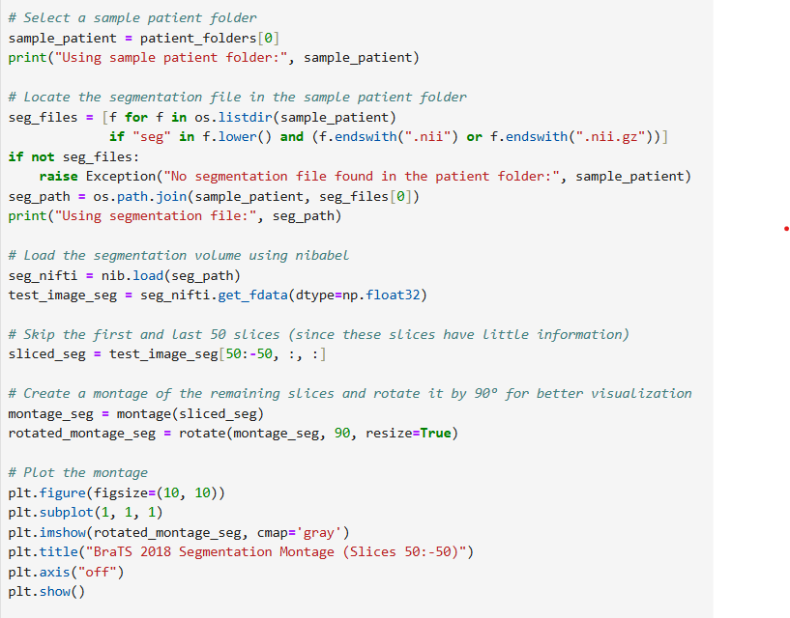
Montage segmentation slices 50-50

Slide 55
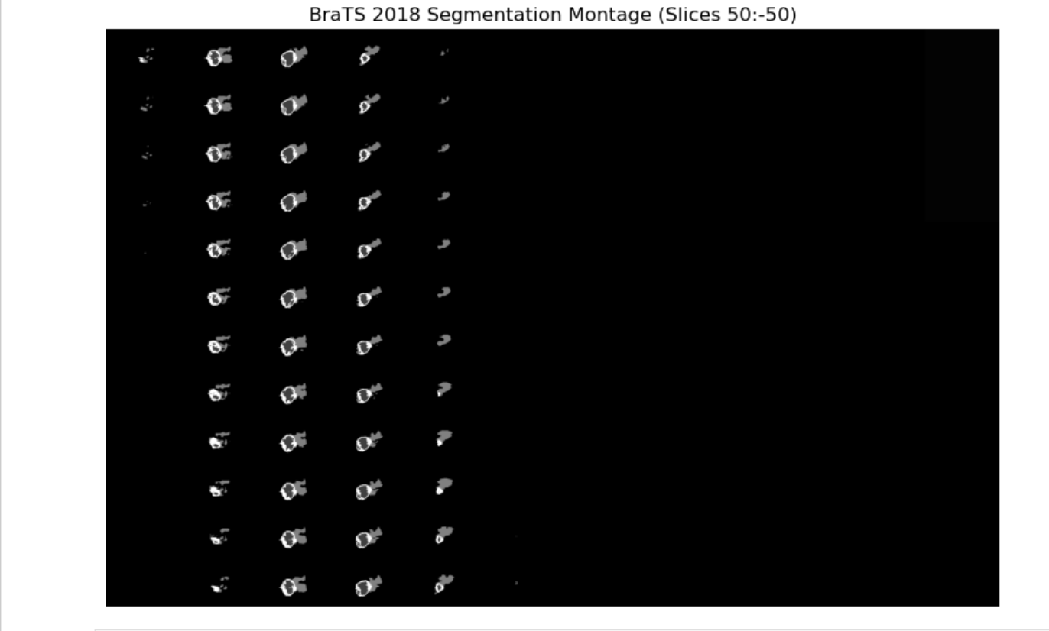

Slide 56
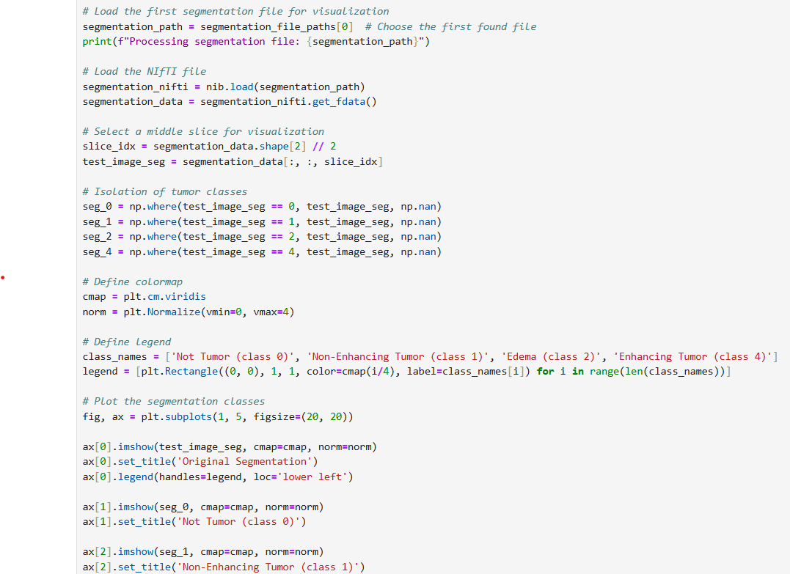
Segmentation

Slide 57
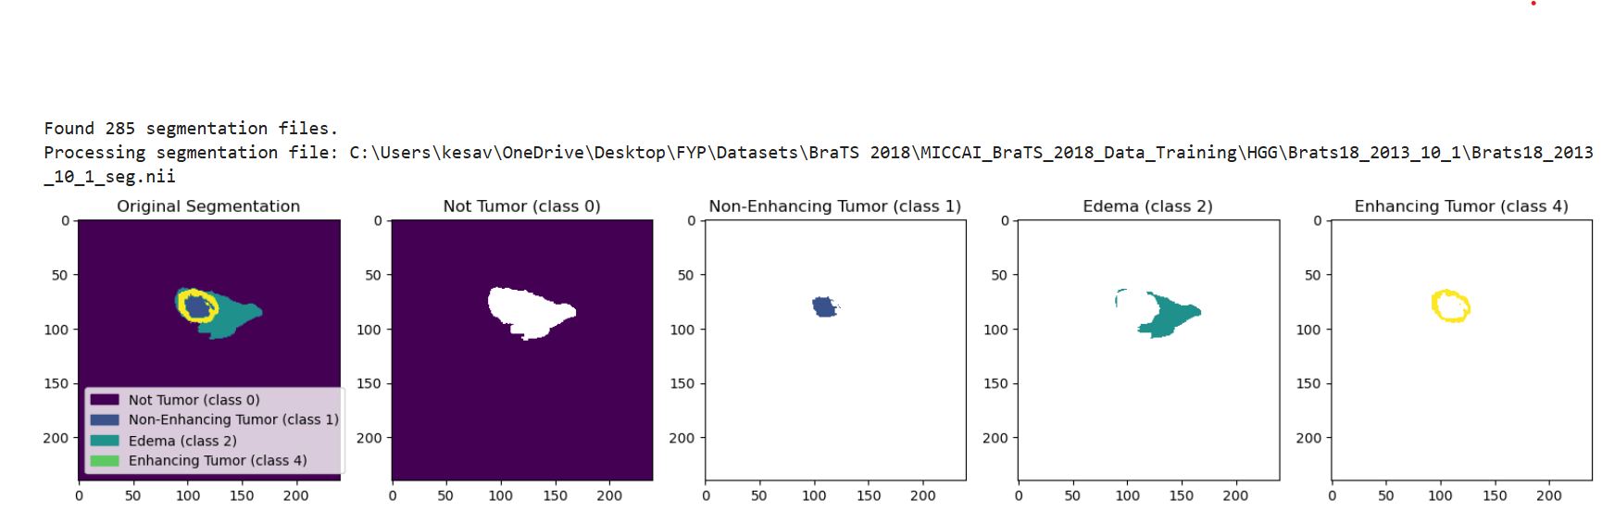
Output
Segmentation

Slide 58
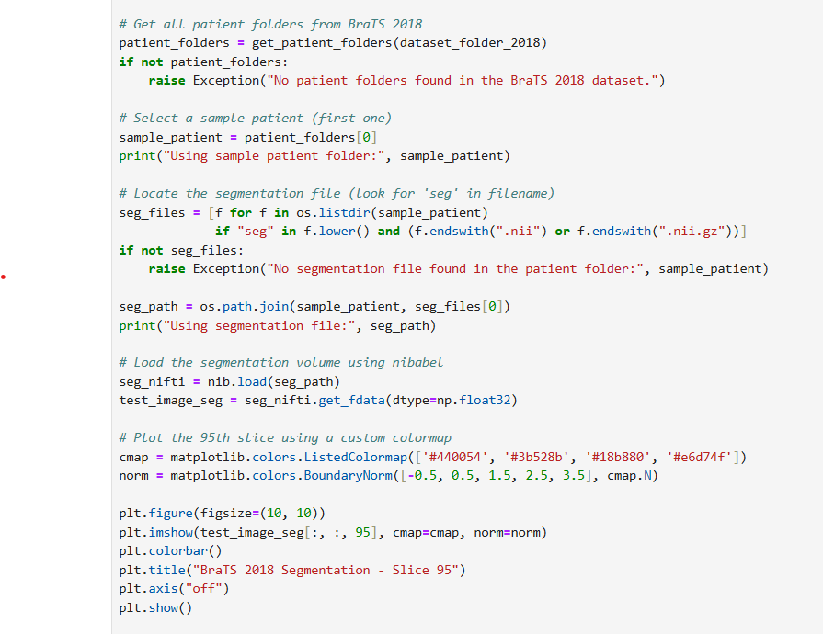

Slide 59
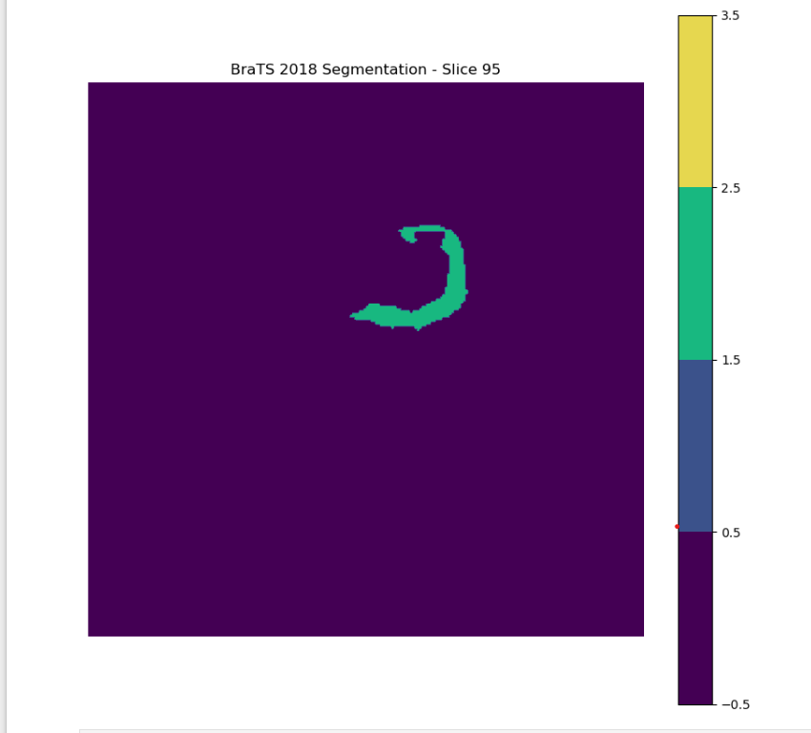

Slide 60
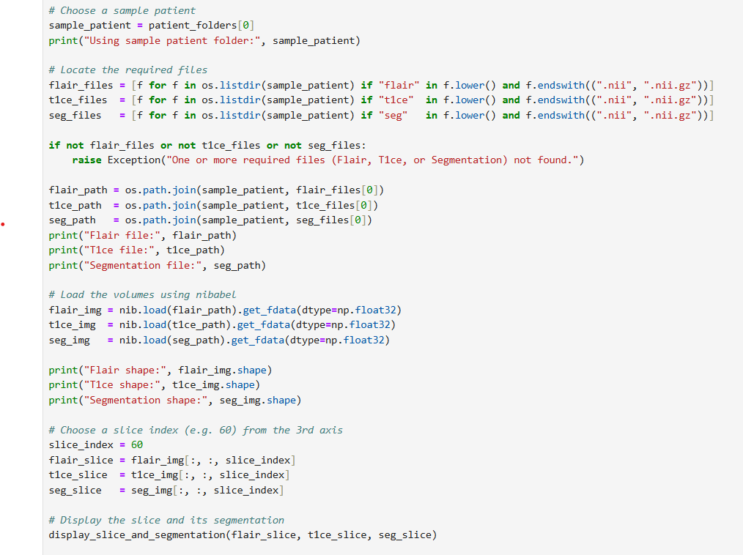
Display Flair,T1ce and Segmentation

Slide 61
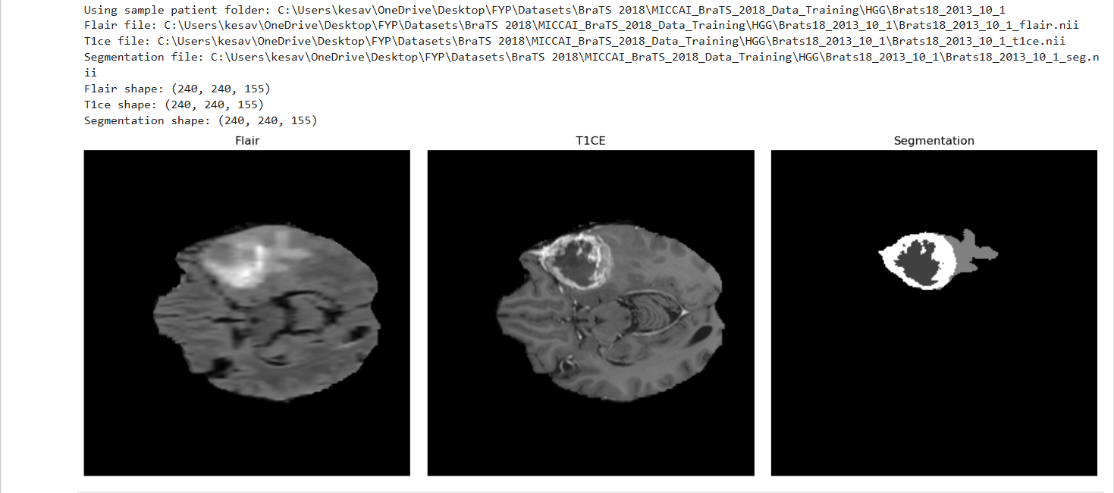
Output

Slide 62
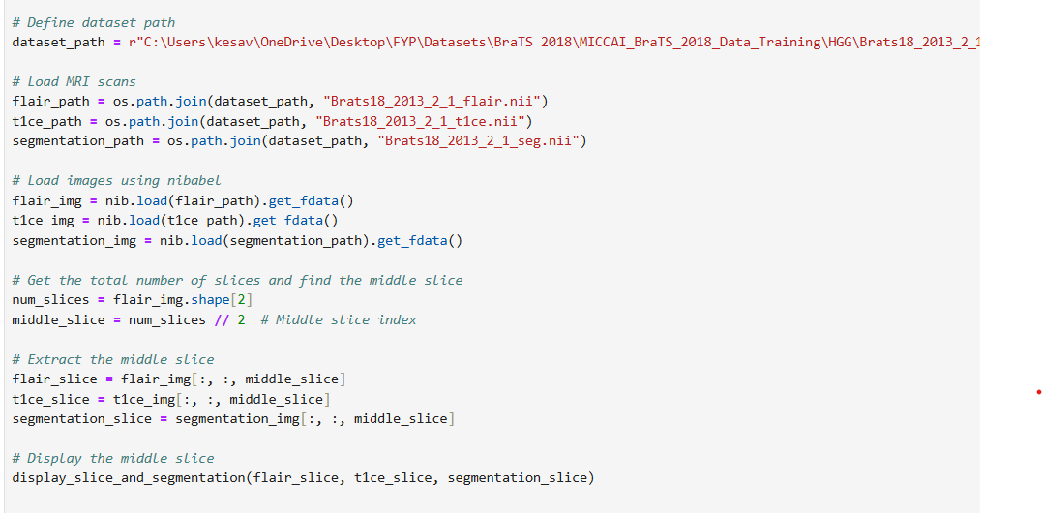

Slide 63
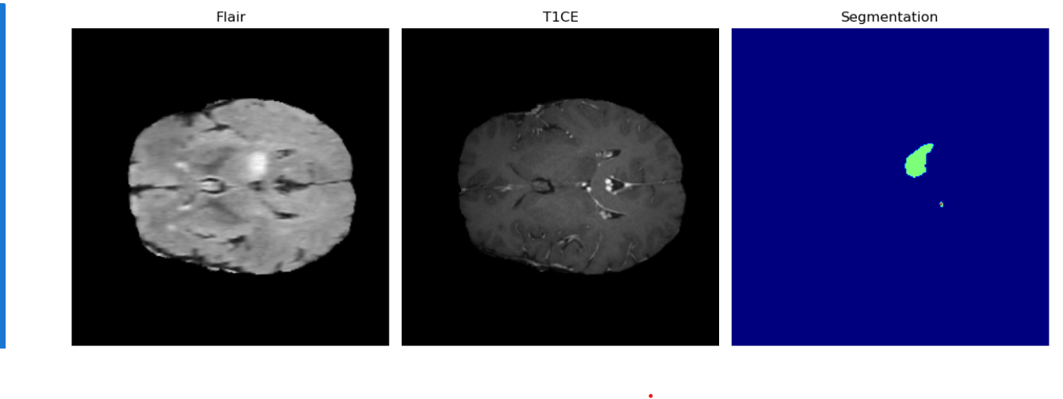
Output

Slide 64
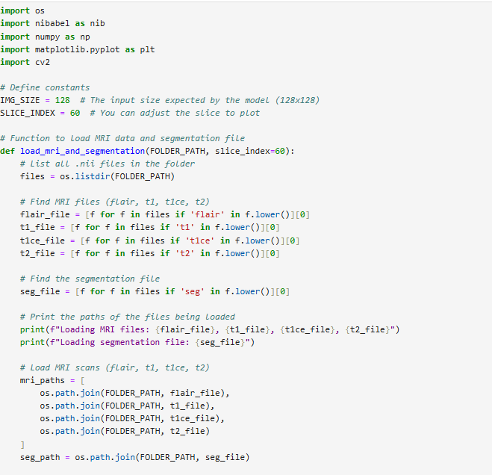
Result Analysis

Slide 65
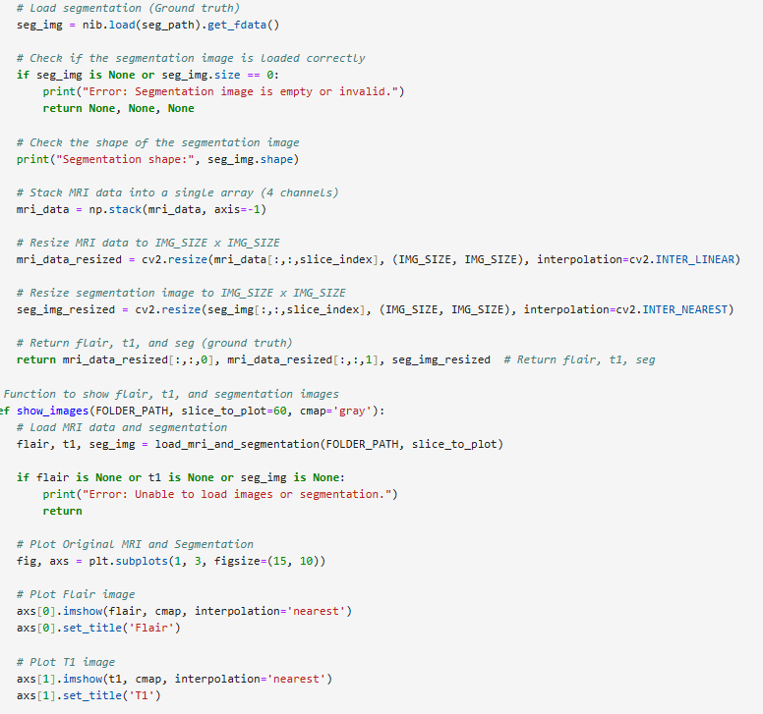

Slide 66
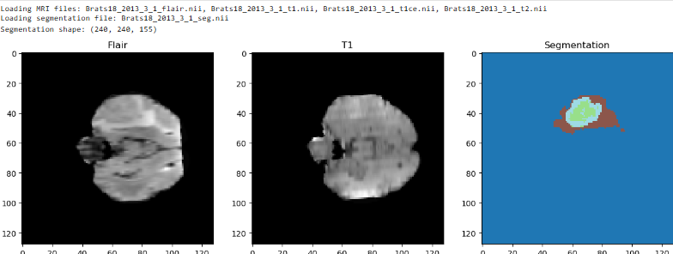
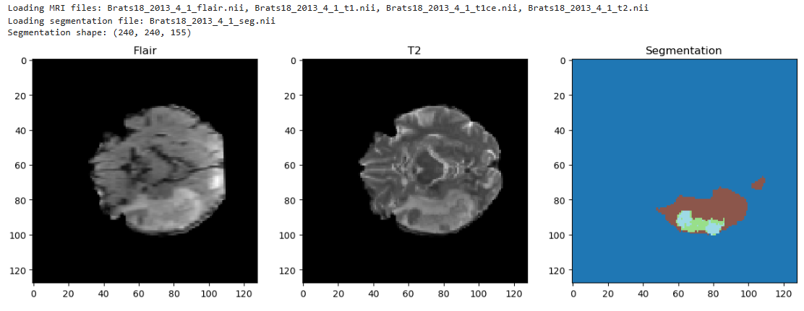
Output

Slide 67
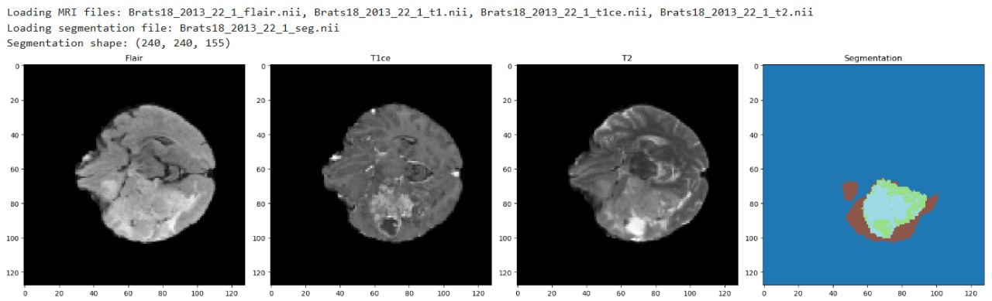
Brats 2018

Slide 68
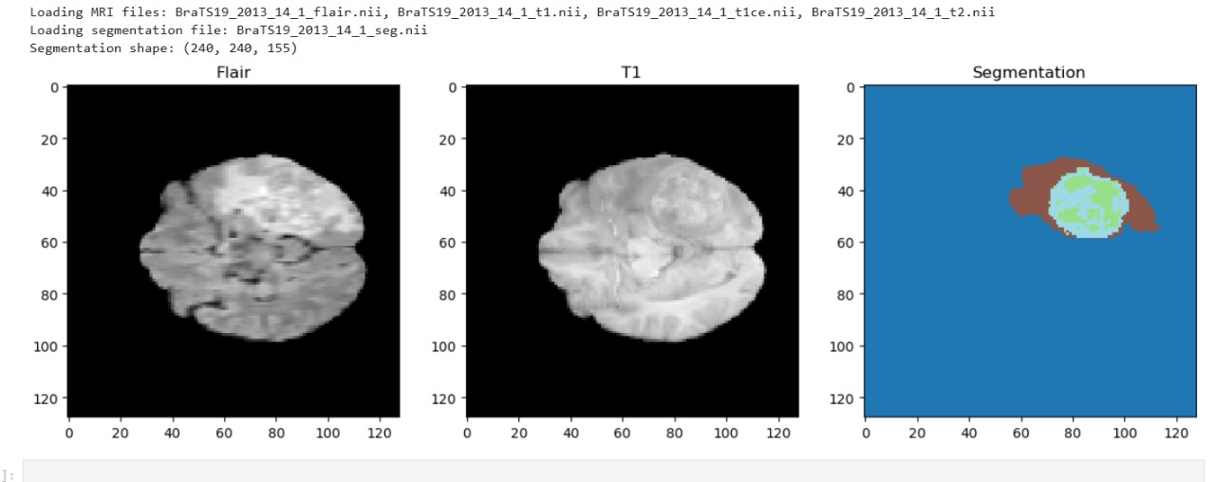
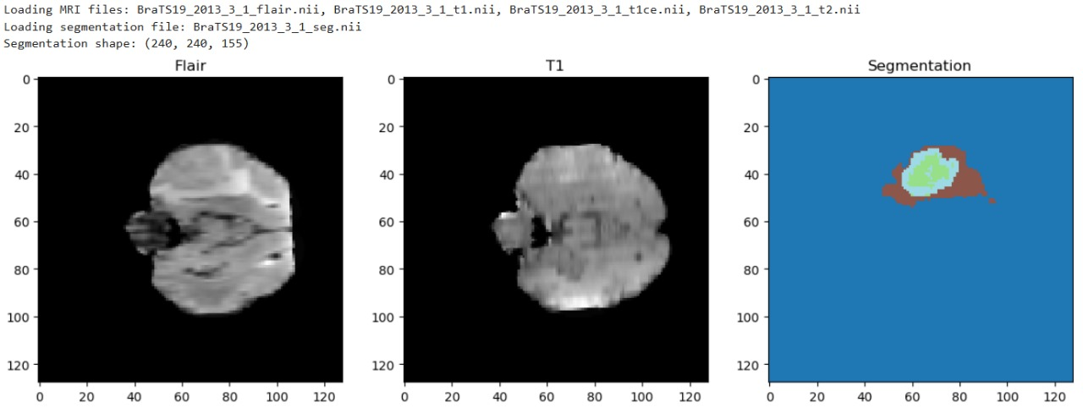

Slide 69
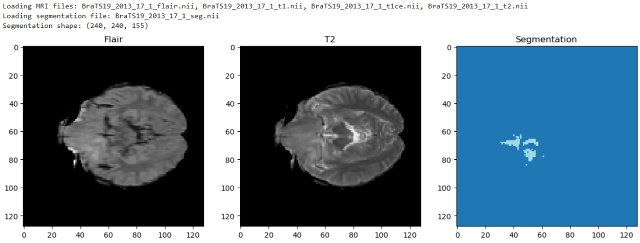

Slide 70
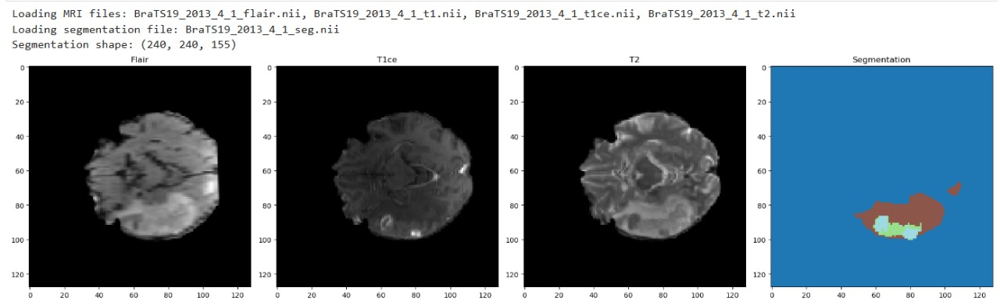
Brats 2019

Slide 71
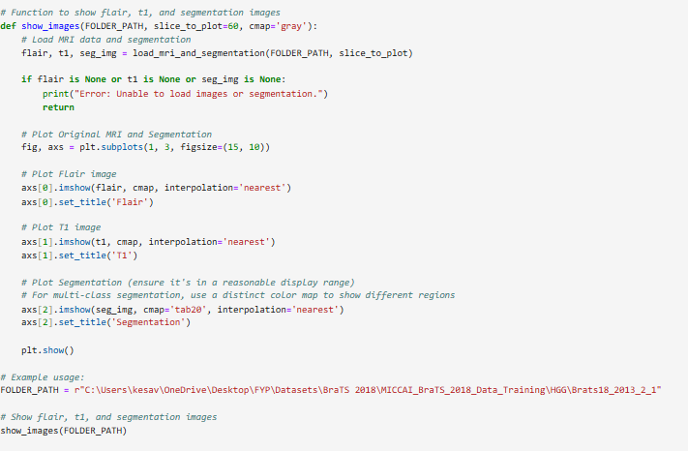
TEST CASE
FALSE CASE

Slide 72
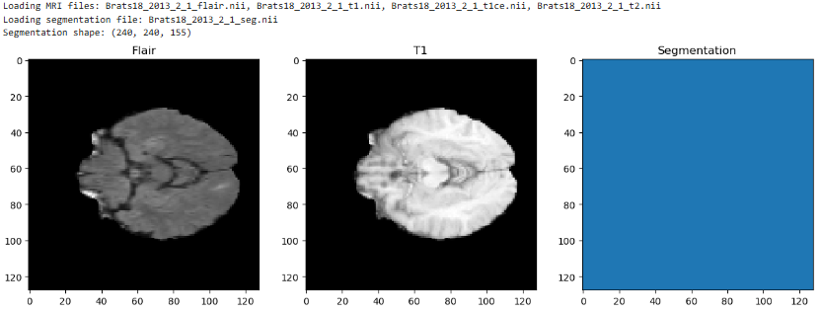

Slide 73
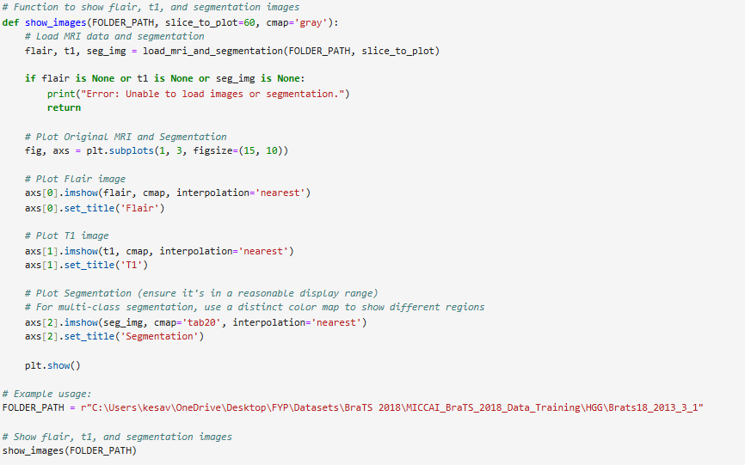
TRUE CASE

Slide 74
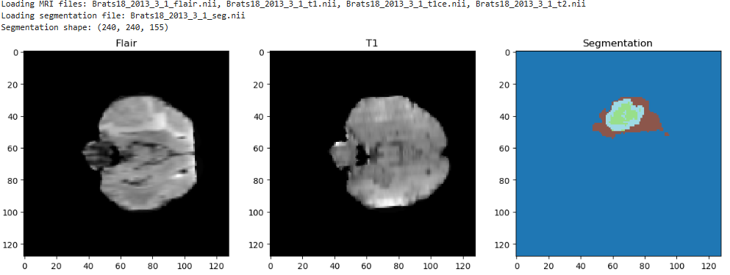

Slide 75
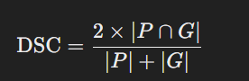
Performance Measures
1.Dice Similarity Coefficient (DSC)
Measures the overlap between the predicted segmentation and the ground truth.
Formula:
Range: 0 (no overlap) to 1 (perfect overlap).
Key metric for segmentation accuracy.

Slide 76
Accuracy
In Deep Learning (DL), accuracy is a performance metric used to measure how well a model is making correct predictions.
Formula :
Accuracy = (Number of Correct Predictions) / (Total Number of Predictions)
It tells you the percentage of times the model got the answer right.
High accuracy means your model is doing well

Slide 77
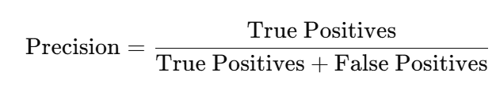
Precision
Precision is a performance metric that measures the proportion of positive predictions that are actually correct.
It is especially useful when the cost of false positives is high.

Slide 78
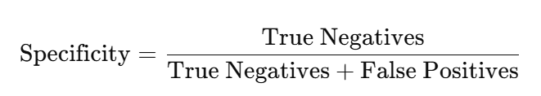
Specificity
Specificity is a performance metric that measures the proportion of actual negative cases that are correctly identified as negative by the model.
It is crucial when the cost of false positives is high, as it ensures the model does not incorrectly classify non-tumor areas as tumor.

Slide 79
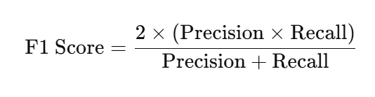
F1 Score
The F1 score is the harmonic mean of precision and recall. It provides a single metric that balances both the concerns of precision and recall in situations where there is an uneven class distribution.
It is especially useful when there is a need to balance the performance between the two metrics (precision and recall), especially in cases with imbalanced data.

Slide 80
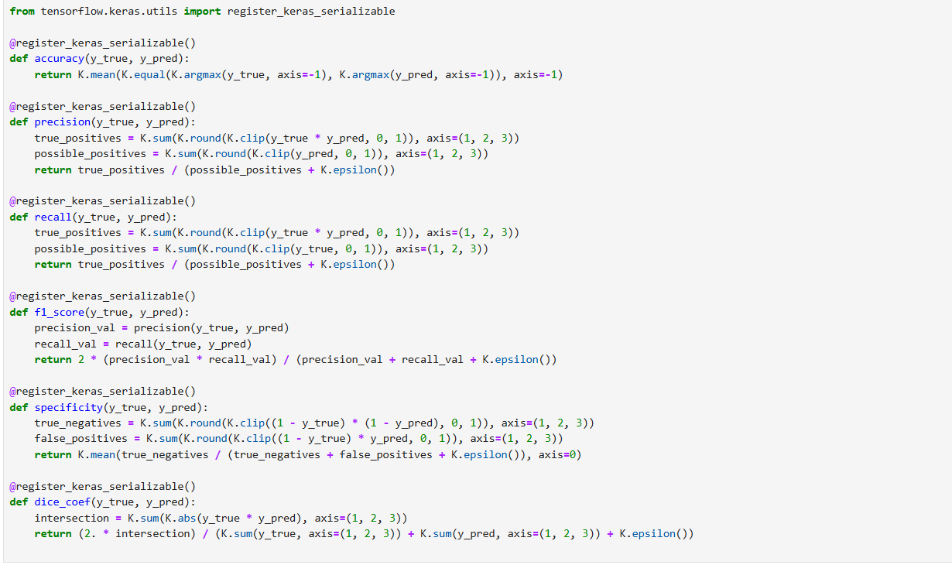
Performance Metrics Code

Slide 81

Performance Metrics

Slide 82

Graph showing Accuracy and Dice Simiarity Coefficient

Slide 83

Graph showing F1 Score and Loss

Slide 84


Graph showing Precision and Specificity

Slide 85
Dataset
Dataset Name: BraTS 2018 and BraTS 2019.
Description: These datasets contain multi-modal brain MRI scans of glioma patients, with labeled tumor regions for segmentation tasks. They include FLAIR, T1, T1c, and T2 sequences.
Content: The datasets include over 200 MRI scans with annotations for whole tumor, tumor core, and enhancing tumor regions.

Slide 86
CONCLUSION AND FUTURE WORK
Future improvements include integrating clinical metadata (age, tumor grade, genetic markers) for personalized predictions.
Enhance model generalization by evaluating on more datasets (e.g., BraTS 2020, 2021) for broader applicability across scanners and institutions.
Expand from 2D to 3D data for richer spatial context and better handling of complex tumor structures.
Explore semi-supervised and weakly-supervised learning to reduce reliance on labeled data.
Optimize the model for real-time clinical use with lightweight architectures and hardware accelerations.
Implement post-processing methods such as CRFs or region-growing techniques to refine results and reduce false positives.

Slide 87
References:
Abidin, Z.U., Naqvi, R.A., Haider, A., Kim, H.S., Jeong, D. and Lee, S.W., 2024. Recent deep learning-based brain tumor segmentation models using multi-modality magnetic resonance imaging: A prospective survey. Frontiers in Bioengineering and Biotechnology, 12, p.1392807.
Feng, Y., Cao, Y., An, D., Liu, P., Liao, X. and Yu, B., 2024. DAUnet: A U-shaped network combining deep supervision and attention for brain tumor segmentation. Knowledge-Based Systems, 285, p.111348.
Aboussaleh, I., Riffi, J., Mahraz, A.M. and Tairi, H., 2024. Inception-UDet: an improved U-Net architecture for brain tumor segmentation. Annals of Data Science, 11(3), pp.831-853.
Li, H.B., Conte, G.M., Hu, Q., Anwar, S.M., Kofler, F., Ezhov, I., van Leemput, K., Piraud, M., Diaz, M., Cole, B. and Calabrese, E., 2024. The brain tumor segmentation (BraTS) challenge 2023: Brain MR image synthesis for tumor segmentation (BraSyn). ArXiv, pp.arXiv-2305.
Karimijafarbigloo, S., Azad, R., Kazerouni, A., Ebadollahi, S. and Merhof, D., 2024, January. Mmcformer: Missing modality compensation transformer for brain tumor segmentation. In Medical Imaging with Deep Learning (pp. 1144-1162). PMLR.

Slide 88
Zhang, W., Chen, S., Ma, Y., Liu, Y. and Cao, X., 2024. ETUNet: Exploring efficient transformer enhanced UNet for 3D brain tumor segmentation. Computers in Biology and Medicine, 171, p.108005.
B. H. Menze et al., “The Multimodal Brain Tumor Image Segmentation Benchmark (BRATS),” IEEE Transactions on Medical Imaging, vol. 34, no. 10, pp. 1993–2024, 2015, doi: 10.1109/TMI.2014.2377694.
Zhou, T., 2024. M2GCNet: Multi-Modal Graph Convolution Network for Precise Brain Tumor Segmentation Across Multiple MRI Sequences. IEEE Transactions on Image Processing.
Pereira, S., Pinto, A., Alves, V. and Silva, C.A., 2016. Brain tumor segmentation using convolutional neural networks in MRI images. IEEE transactions on medical imaging, 35(5), pp.1240-1251.
Patel, D., Patel, D., Saxena, R. and Akilan, T., 2023, July. Multi-class brain tumor segmentation using graph attention network. In 2023 8th International Conference on Signal and Image Processing (ICSIP) (pp. 196-201). IEEE.

Slide 89
Ramkumar, M., Kumar, R.S., Padmapriya, R. and Karthick, S., 2024. Brain tumor segmentation and survival time prediction using graph momentum fully convolutional network with modified Elman spike neural network. International Journal of Imaging Systems and Technology, 34(1), p.e23005.
Hussain, S., Anwar, S.M. and Majid, M., 2017, July. Brain tumor segmentation using cascaded deep convolutional neural network. In 2017 39th annual International Conference of the IEEE engineering in medicine and biology Society (EMBC) (pp. 1998-2001). IEEE.
Hu, K., Gan, Q., Zhang, Y., Deng, S., Xiao, F., Huang, W., Cao, C. and Gao, X., 2019. Brain tumor segmentation using multi-cascaded convolutional neural networks and conditional random field. IEEE Access, 7, pp.92615-92629.
Nizamani, A.H., Chen, Z., Nizamani, A.A. and Bhatti, U.A., 2023. Advance brain tumor segmentation using feature fusion methods with deep U-Net model with CNN for MRI data. Journal of King Saud University-Computer and Information Sciences, 35(9), p.101793.
Ottom, M.A., Rahman, H.A. and Dinov, I.D., 2022. Znet: deep learning approach for 2D MRI brain tumor segmentation. IEEE Journal of Translational Engineering in Health and Medicine, 10, pp.1-8.
Islam, M. and Ren, H., 2017, September. Fully convolutional network with hypercolumn features for brain tumor segmentation. In Proceedings of MICCAI workshop on multimodal brain tumor segmentation challenge (BRATS).

